Slide 1

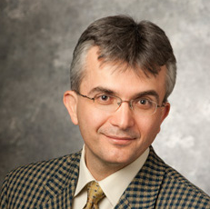
Towards Rawlsian fairness in food rescue
Gerdus Benade
With Aydin Alptekinoglu

Slide 2
Food insecurity and waste is common
USDA data on incidence of food insecurity in 2022 say:
12.8% of U.S. households
14.1% of global households
USDA estimates:
31% of all food in the US is wasted somewhere along the supply chain
92 billion lbs of food
Food rescue tries to address both issues at once
Match organizations with excess food to organizations that can distribute it where needed, in a timely manner
Notes:
ReFED (a nonprofit dedicated to fight food loss and waste)
Strengthening food rescue is among the seven key action areas they advocates for the next ten year

Slide 3
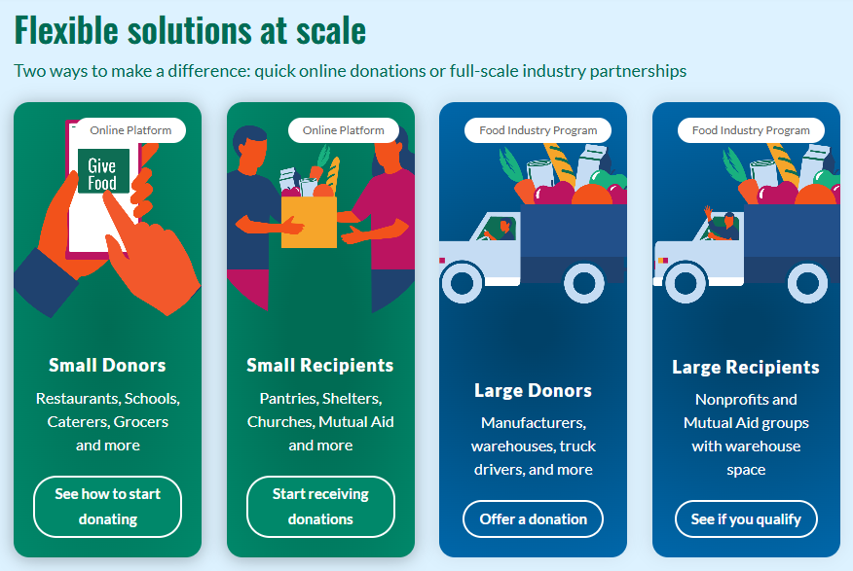
Setting: a national food rescue platform
Active in 50 states in the US
Distributed 2.9M pounds of food in 2022, 81M in 2024
Acts as a matching platform between donors and recipients
Notes:
FL in 2023: ~20 mil pounds. Exciting time to be involved with them.

Slide 4
Setting: a national food rescue platform
Active in 50 states in the US
Distributed 2.9M pounds of food in 2022, 81M pounds in 2024
Acts as a matching platform between donors and recipients
We focus on donations below 3,000 pounds
Employs FCFS (first-come-first-serve) matching – first to claim a posted donation gets it, which results in inequities in distribution
Goal: To improve fairness outcomes in such food rescue platforms that operate on the basis of FCFS matching
Notes:
FL in 2023: ~20 mil pounds. Exciting time to be involved with them.

Slide 5

Food rescue operations
Act as a matching platform between donors and recipients
Each recipient sets a pickup radius, on avg. ~55km.
Notes:
Recipients are food pantries/ soup kitchens not individuals. Pickup radius, also categories interested in

Slide 6


Food rescue operations
Act as a matching platform between donors and recipients
Notes:
Different radii

Slide 7
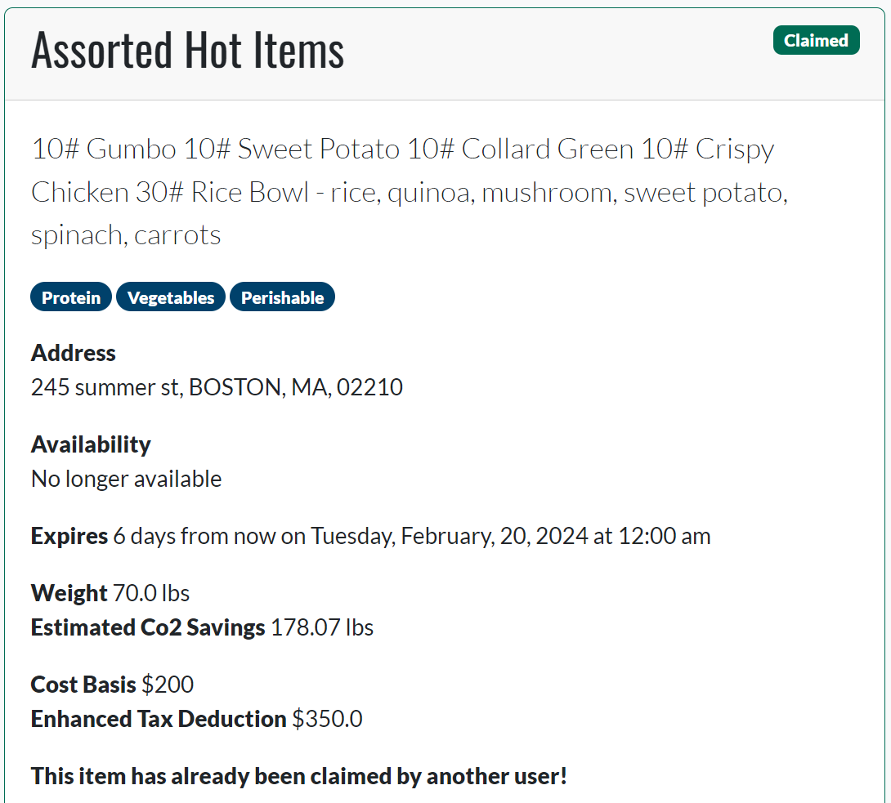
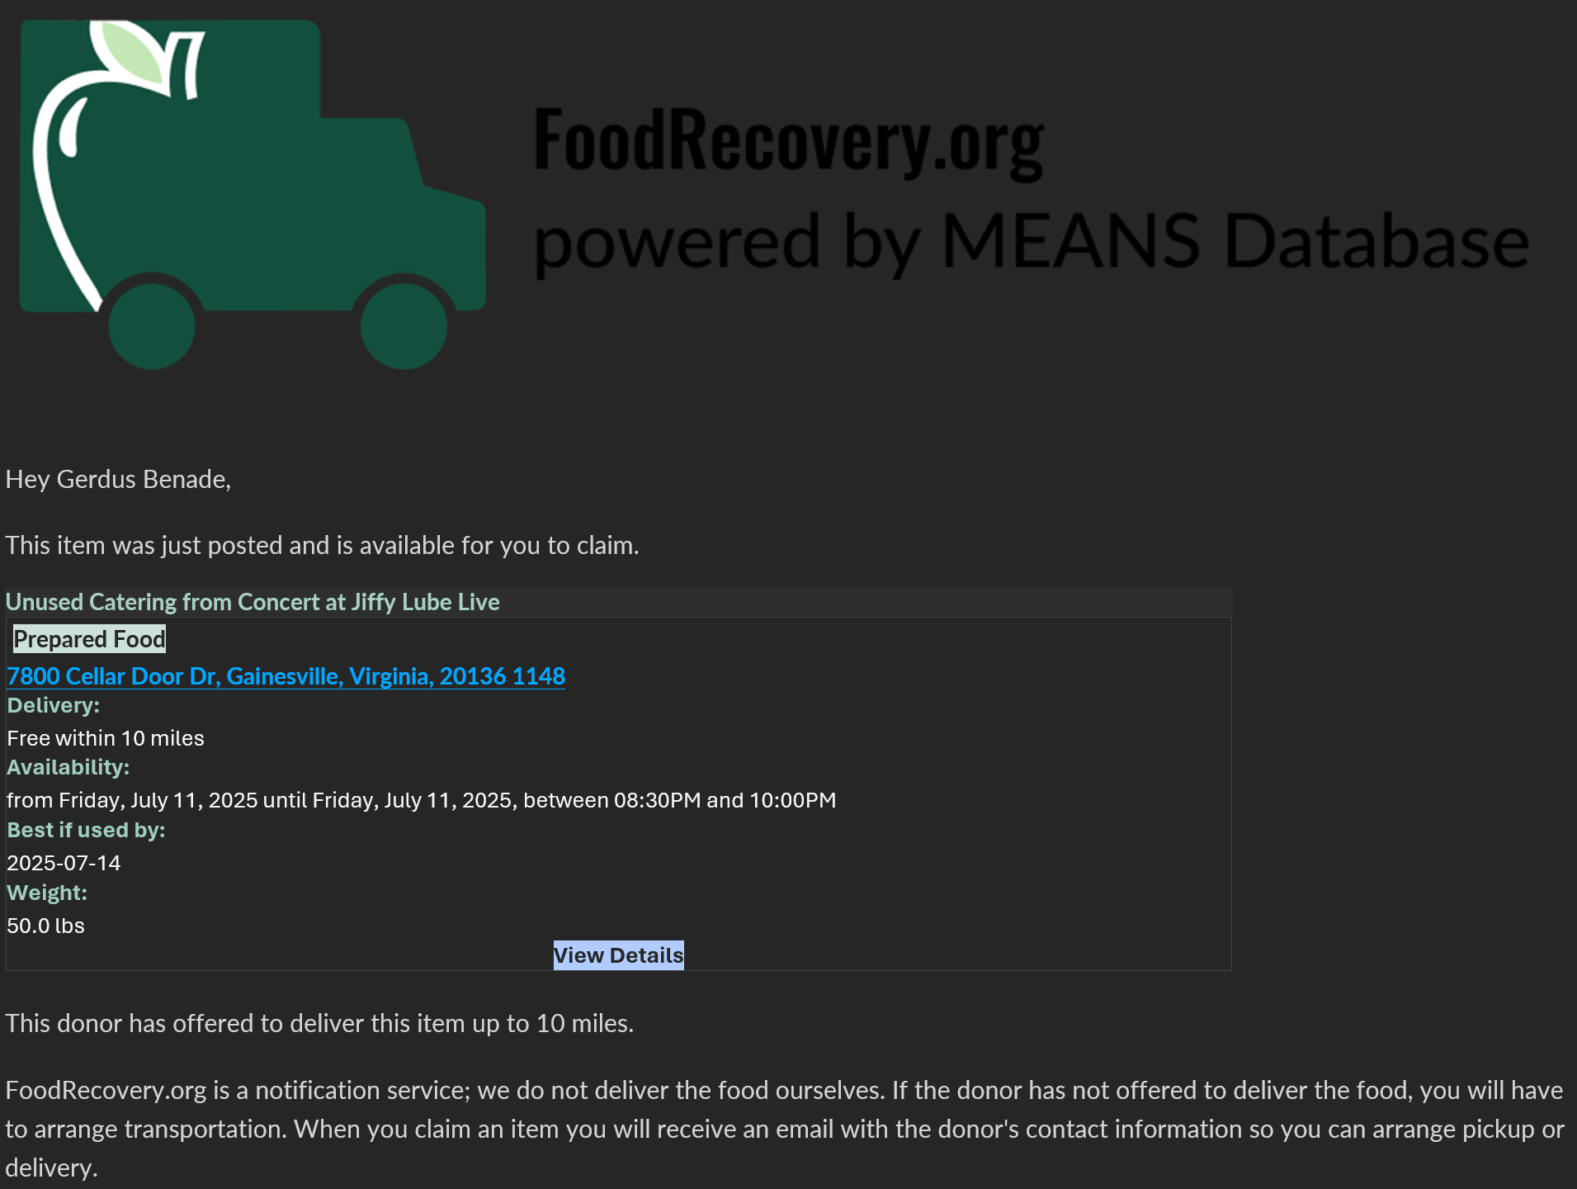
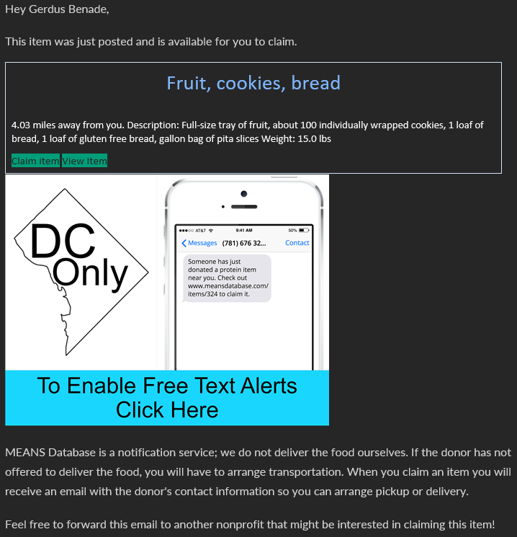

Slide 8

Food rescue operations
Act as a matching platform between donors and recipients
Notes:
Donation arrives – donors: farms/ larger scale factories / bakeries / catering companies or schools with prepared food

Slide 9
Food rescue operations
Act as a matching platform between donors and recipients
Notes:
Emphasize: recipient does transport (trying to offer delivery in a couple of states)
Deadline – expiration or shelf space

Slide 10
Food rescue operations
Act as a matching platform between donors and recipients
YES

Slide 11
Food rescue operations
Act as a matching platform between donors and recipients

Slide 12

Food rescue operations
Act as a matching platform between donors and recipients
YES
Notes:
Don’t know, and can’t elicit, agent values
We don’t get to make an allocation

Slide 13
Food rescue operations
Act as a matching platform between donors and recipients
Notes:
Don’t know, and can’t elicit, agent values
We don’t get to make an allocation

Slide 14
Food rescue operations
Act as a matching platform between donors and recipients
Active in 50 states, 2.9M pounds in 2022, 81M pounds in 2024
Historically
Vast majority of donations are successfully claimed
~90% of matched items travel less than 50km
Average claim time ~5.5 hours, avg. deadline 210 hours
Notes:
Bulk donations separate, drivers experiments in some cities, agreements with recurring donors

Slide 15
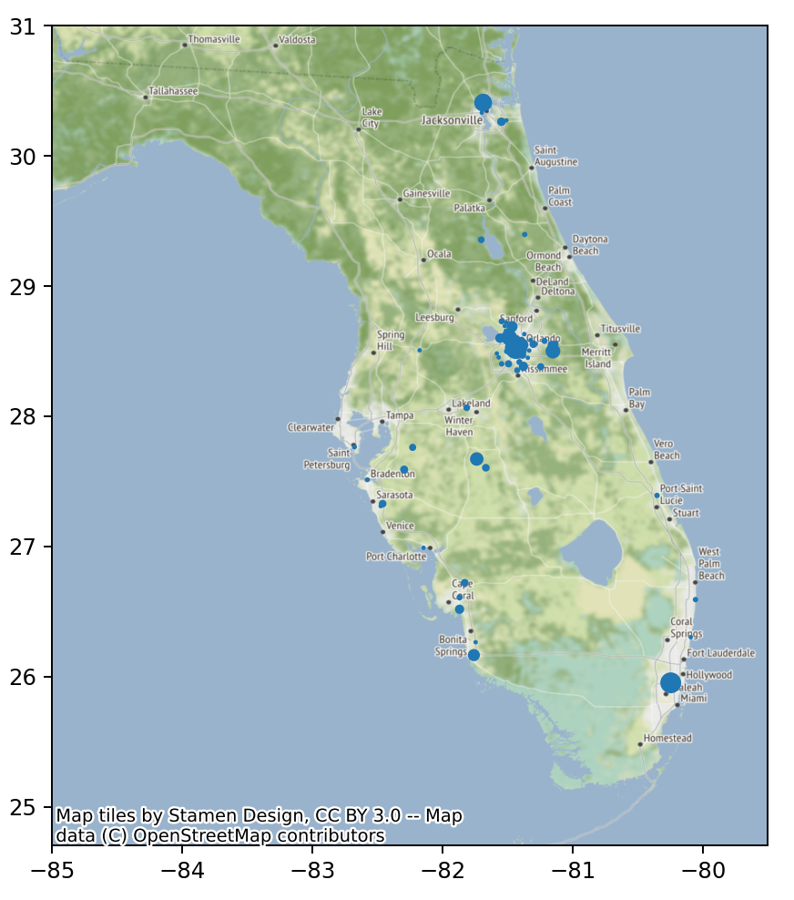
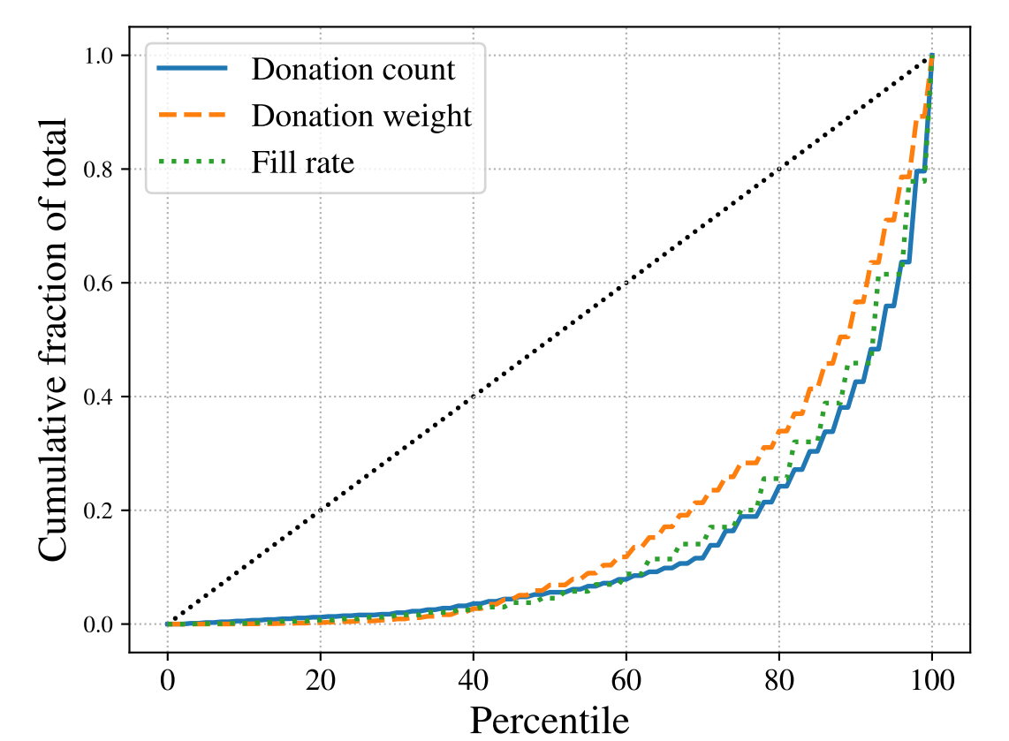
Historical allocations: May 2021 – Sept 2023
Bottom 60% of recipients get 13% of weight
Bottom 60% of recipients get 8% of items
Notes:
These plots only consider those recipients that have received something since 2018
~70% of recipients signed up in FL have never received anything
Similar size organizations, all vying for relatively small donations <3000lbs, no bulk donations
Minimal changes from current system
- claiming system – cant allocate
- no value elicitation

Slide 16
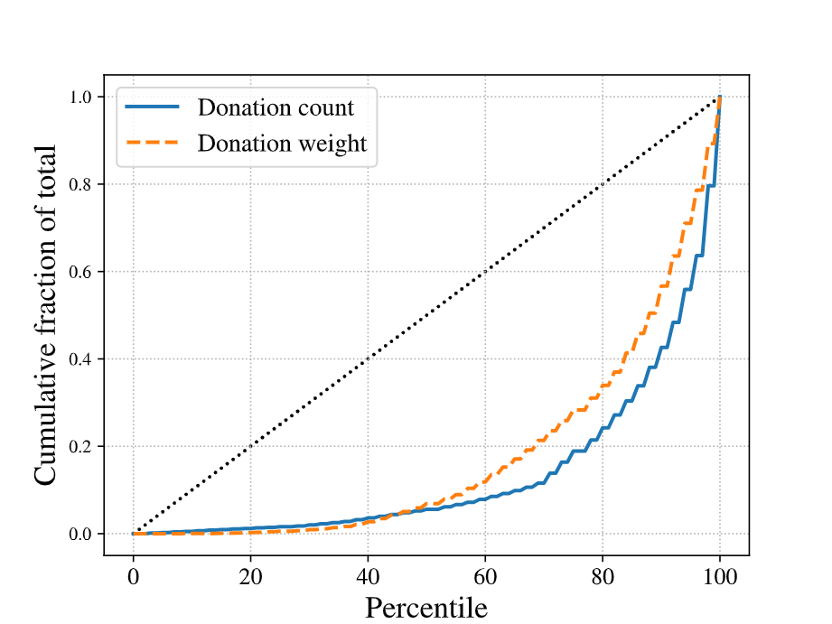

Slide 17
Our theory doesn’t really fit
Model
Here
Items arrive online
Agents have values for items
Fairness metric: envy
Algorithm decides allocation
Items arrive online
We don’t know item values
Can’t use envy as metric
Algorithm doesn’t get to allocate
Response rates

Slide 18






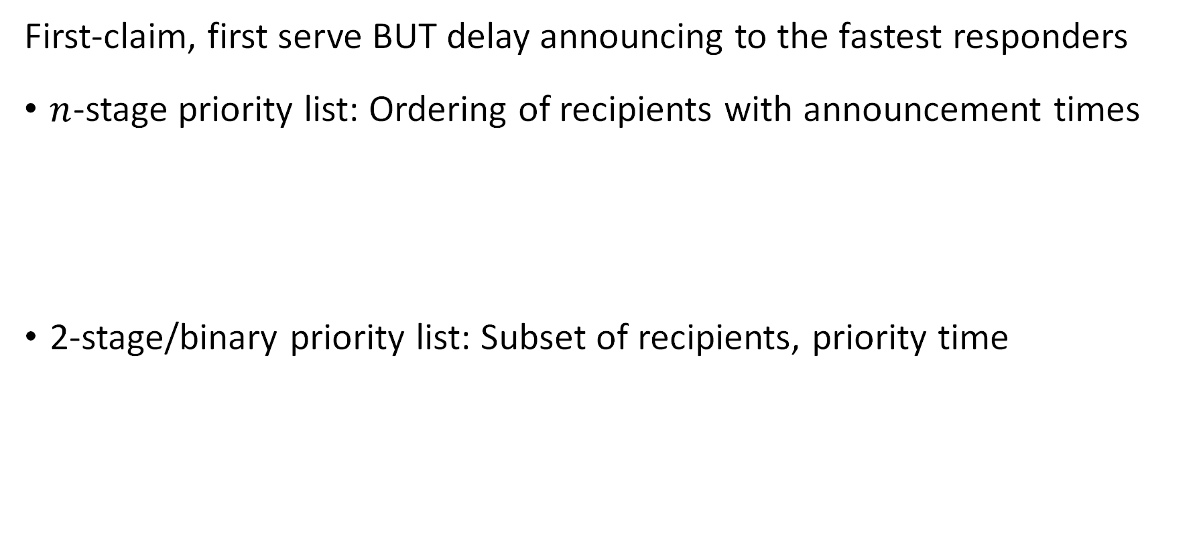
Priority lists
First-claim, first serve BUT delay announcing to the fastest responders
$n$-stage priority list: Ordering of recipients with announcement times
2-stage/binary priority list: Subset of recipients, priority time
1hr
3hrs
2 days
0
2hrs
2 days
0
Notes:
You could imagine other things, artificial currency, wait for two to respond give to worst-off etc

Slide 19
Simple idea to improve fairness Prioritize select recipients by giving them a headstart

Slide 20
Priority lists
First-claim, first serve BUT delay announcing to the fastest responders
$n$-stage priority list: Ordering of recipients with announcement times
2-stage/binary priority list: Subset of recipients, priority time
0
1hr
3hrs
2 days
0
2hrs
2 days
Notes:
You could imagine other things, artificial currency, wait for two to respond give to worst-off etc
Added benefit – existed in some form eg church of some denomination prefers donation goes to food pantry of same denomination

Slide 21
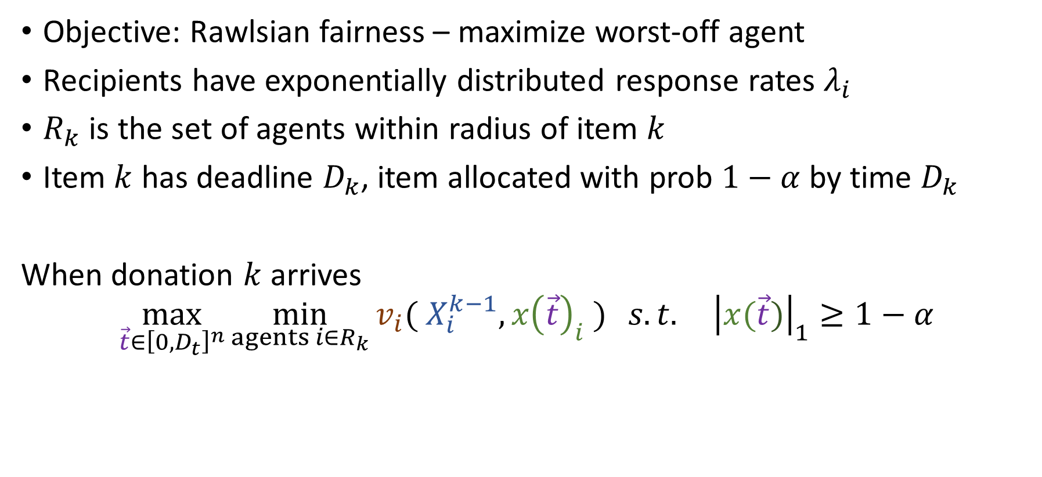
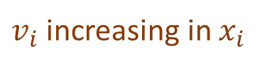
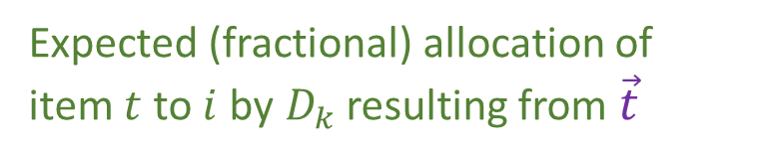
Model
Objective: Rawlsian fairness – maximize worst-off agent
Recipients have exponentially distributed response rates $λ_{i}$
$R_{k}$ is the set of agents within radius of item $k$
Item $k$ has deadline $D_{k}$, item allocated with prob $1−α$ by time $D_{k}$
When donation $k$ arrives
$$\max_{\vec{t}∈{\left[0,D_{t}\right]}^{n}}{\min_{agents i∈R_{k}}{v_{i}( X_{i}^{k−1}, x{\left(\vec{t}\right)}_{i} )} s.t. {\left|x(\vec{t})\right|}_{1}≥1−α}$$
Wastage constraint
Existing allocation of prior items
$v_{i}$ increasing in $x_{i}$
Expected (fractional) allocation of item $t$ to $i$ by$D_{k}$ resulting from $\vec{t}$
Vector of announcement times
Number of items
Pounds of items
Frac. of agent’s demand
Notes:
Objective – max unique recipients. Little demand information, couple of surveys, contacts etc, still enough uncertainty about what makes a reasonable objective.

Slide 22
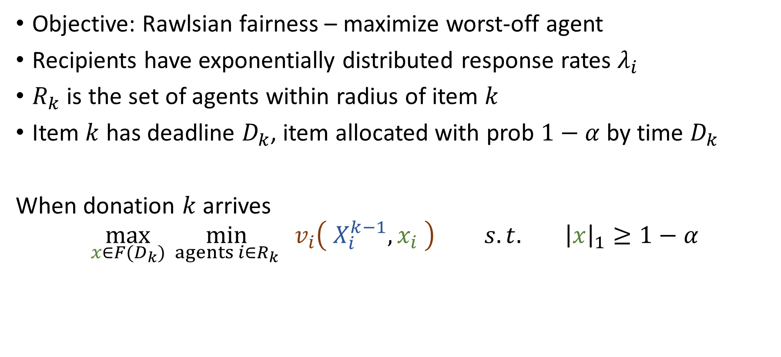

Model
Objective: Rawlsian fairness – maximize worst-off agent
Recipients have exponentially distributed response rates $λ_{i}$
$R_{k}$ is the set of agents within radius of item $k$
Item $k$ has deadline $D_{k}$, item allocated with prob $1−α$ by time $D_{k}$
When donation $k$ arrives
$$\max_{x∈F(D_{k})}{\min_{agents i∈R_{k}}{v_{i}\left( X_{i}^{k−1}, x_{i} \right) } s.t. {\left|x\right|}_{1}≥1−α}$$
Wastage constraint
Existing allocation of prior items
$v_{i}$ increasing in $x_{i}$
Expected (fractional) allocation of item $t$ to $i$ by$D_{k}$
Feasible fractional allocations by deadline
Number of items
Pounds of items
Frac. of agent’s demand
Notes:
Objective – max unique recipients. Little demand information, couple of surveys, contacts etc, still enough uncertainty about what makes a reasonable objective.

Slide 23
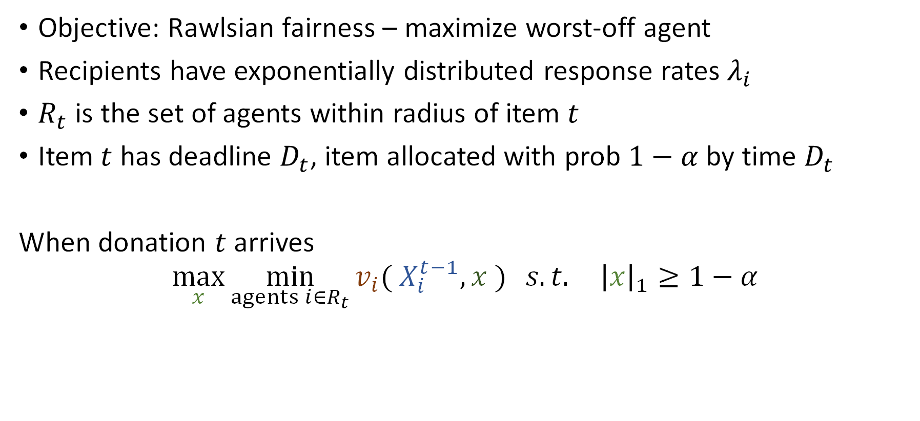
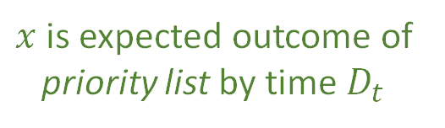
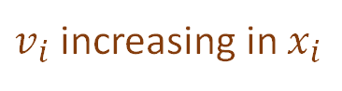

Model
Objective: Rawlsian fairness – maximize worst-off agent
Recipients have exponentially distributed response rates $λ_{i}$
$R_{t}$ is the set of agents within radius of item $t$
Item $t$ has deadline $D_{t}$, item allocated with prob $1−α$ by time $D_{t}$
When donation $t$ arrives
$$\max_{x}{\min_{agents i∈R_{t}}{v_{i}( X_{i}^{t−1}, x )} s.t. {\left|x\right|}_{1}≥1−α}$$
Existing allocation of prior items
Wastage constraint
Expected allocation of item $t$
$v_{i}$ increasing in $x_{i}$
$x$ is expected outcome of priority list by time $D_{t}$
Number of items
Pounds of items
Frac. of agent’s demand
Notes:
Objective – max unique recipients. Little demand information, couple of surveys, contacts etc, still enough uncertainty about what makes a reasonable objective.

Slide 24
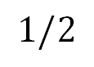
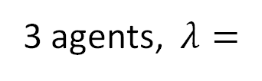

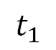

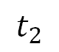
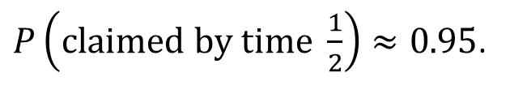

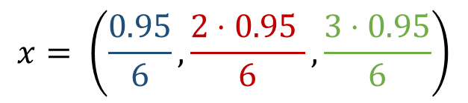
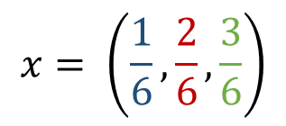
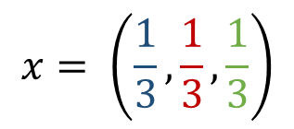
Example
1
2
3
3 agents, $λ=$
No deadline, no priority list
$$x= \left(\frac{1}{6},\frac{2}{6},\frac{3}{6}\right)$$
0
$$∞$$
No deadline, n-stage priority list
$$x= \left(\frac{1}{3},\frac{1}{3},\frac{1}{3}\right)$$
0
$$∞$$
$$t_{1}$$
$$t_{2}$$
Deadline of ½, $α=0.05,$ n-stage priority list
$P\left(claimed by time \frac{1}{2}\right)≈0.95$.
$$x= \left(\frac{0.95}{6},\frac{2⋅0.95 }{6},\frac{3⋅0.95}{6}\right)$$
0
$$1/2$$
Notes:
n-stage can achieve any fraction without deadline, 2 stage obviously cant

Slide 25
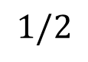

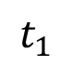

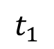
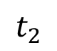
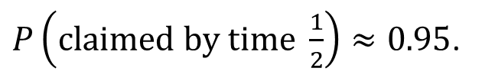

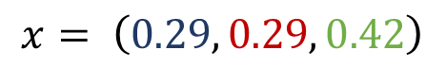
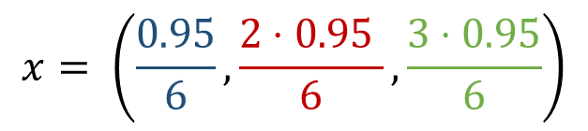
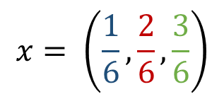


Example
1
2
3
3 agents, $λ=$
No deadline, no priority list
$$x= \left(\frac{1}{6},\frac{2}{6},\frac{3}{6}\right)$$
0
$$∞$$
No deadline, n-stage priority list
$$x= \left(\frac{1}{3},\frac{1}{3},\frac{1}{3}\right)$$
0
$$∞$$
$$t_{1}$$
$$t_{2}$$
No deadline, binary priority list
$$x= \left(0.29, 0.29, 0.42\right)$$
0
$$∞$$
$$t_{1}$$
Deadline of ½, $α=0.05,$ n-stage priority list
$P\left(claimed by time \frac{1}{2}\right)≈0.95$.
$$x= \left(\frac{0.95}{6},\frac{2⋅0.95 }{6},\frac{3⋅0.95}{6}\right)$$
0
$$1/2$$
Notes:
n-stage can achieve any fraction without deadline, 2 stage obviously cant

Slide 26
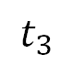
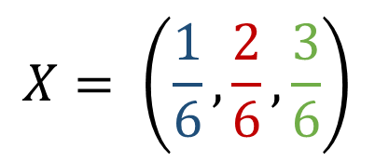
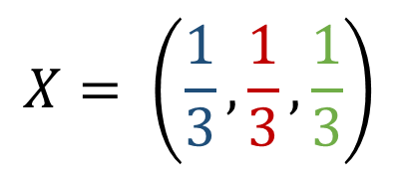
$$X= \left(\frac{1}{6},\frac{2}{6},\frac{3}{6}\right)$$
1
2
3
$$t_{2}$$
$$t_{3}$$
$$X= \left(\frac{1}{3},\frac{1}{3},\frac{1}{3}\right)$$
1
1
2
1
2
3

Slide 27

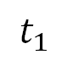
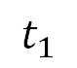
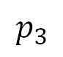
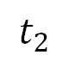
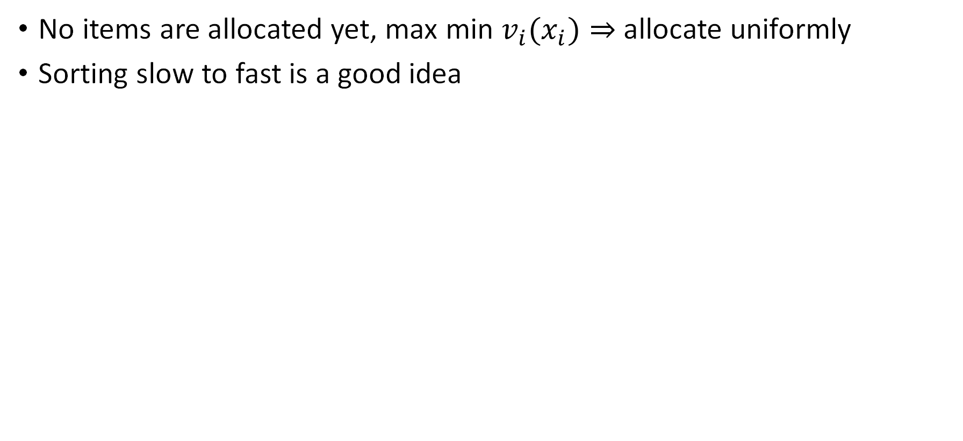
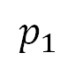

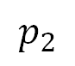
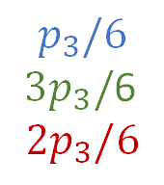
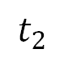
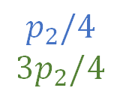
Allocating the first item
No items are allocated yet, max min ${v_{i}(x}_{i})⇒$ allocate uniformly
Sorting slow to fast is a good idea
0
$$∞$$
$$t_{1}$$
$$t_{2}$$
$$p_{1}$$
$$p_{2}$$
$$p_{3}$$
$$t_{1}$$
$$t_{2}$$
1
3
2
$$p_{1}$$
$$p_{2}/4$$
$$3p_{2}/4$$
$$p_{3}/6$$
$3p_{3}/$6
$$2p_{3}/6$$
doesn’t need a head-start over
3
2

Slide 28
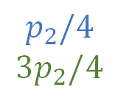

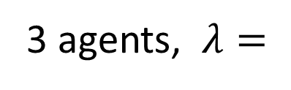
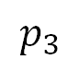
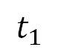
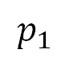


Warm-up: Allocating the first item
No items are allocated yet, max min ${v_{i}(x}_{i})⇒$ allocate uniformly
Sorting slow to fast is a good idea
3 agents, $λ=$
1
2
3
$$p_{1}$$
$$p_{2}$$
$$p_{3}$$
0
$$t_{1}$$
$$t_{2}$$
$$p_{1}$$
$$p_{2}/4$$
$$3p_{2}/4$$
$$p_{3}/6$$
$3p_{3}/$6
$$2p_{3}/6$$
doesn’t need a head-start over
3
2
Notes:
Suppose we don’t sort slow to fast

Slide 29









Allocating the first item
1
2
3
No items are allocated yet, max min $x_{i}$
Sorting slow to fast is a good idea, $π$
Lemma. Given BPL $(S, t)$, if $S$ is not a prefix of $π,$ you can find $S_{1}⊂S⊂S_{2}, t^{′}$ so that look ‘identical’ on $S_{1}$
$$S$$
$$t$$
$$S_{1}$$
$$t′$$
$$S_{2}$$
$$t$$
Thm. The optimal priority set in a binary priority list is some prefix of $π.$
Given the set you can find the optimal priority time with a linear program.

Slide 30





Designing optimal priority lists – a priority index
First item: Sort response rates ($λ_{i}$), prioritize slow to fast
Generally: consider speed and historical allocation
For any obj. value ${z, x}_{i}^{z}$ is the minimal amount $i$ needs to reach $z$
Slow $→$ small $λ$ $→$ large ratio $→$ high priority
Little prior allocations $→$ large $x^{z}→$ large ratio $→$ high priority
$$\text{Target} z=10$$
New item: weight 10
$$6$$
$$3$$
10
14
4
7
$x^{z}$ 0.6 0 0.3 0
Permutation $π$ sorts recipients by decreasing $x_{i}^{z}/λ_{i}$
Notes:
From now on index in this decreasing order

Slide 31












Binary priority lists
Assume recipients are indexed by $π$ – by decreasing $x_{i}^{z}/λ_{i}$
Lemma. Given BPL $(S, t)$, if $S$ is not a prefix of $π,$ you can find $S_{1}⊂S⊂S_{2}, t^{′}$:
Feasible: Equal P(claimed by $t)$
$x_{i}^{′}\left(t\right)≥x_{i}\left(t\right) ∀$ $i∉S∖S_{1}$
$$S$$
$$t$$
$$S_{1}$$
$$t′$$
$$S_{2}$$
$$t$$
$$S$$
1
2
4
$$t$$
1
2
3
4
1
2
$$t′$$
1
2
3
4
$$t$$
1
2
3
4
$$S_{1}$$
$$S_{2}$$
Notes:
If original satisfies allocation constraint, we still do
Objective weakly increases

Slide 32


Binary priority lists
Assume recipients are indexed by $π$ – by decreasing $x_{i}^{z}/λ_{i}$
Combine with binary search over $z$, checking $n$ prefixes each time
Lemma. Given BPL $(S, t)$, if $S$ is not a prefix of $π,$ you can find $S_{1}⊂S⊂S_{2}, t^{′}$:
Feasible: Equal P(claimed by $t)$
$x_{i}^{′}\left(t\right)≥x_{i}\left(t\right) ∀$ $i∉S∖S_{1}$
$$S$$
$$t$$
$$S_{1}$$
$$t′$$
$$S_{2}$$
$$t$$
Thm. Any achievable $z$ can be achieved with a prefix of $π$ as priority set.
Given the set, find the optimal priority time with an LP.
Notes:
Binary search over z

Slide 33



Designing optimal priority lists – a priority index
First item: Sorting slow to fast is a good idea
Generally: consider response rate ($λ_{i}$) and historical allocation
For any target obj. ${z, x}_{i}^{z}$ is the minimal amount $i$ needs to reach $z$
Let $π$ sort by decreasing $x_{i}^{z}/λ_{i}$
Thm. For any objective value $z,$ if $z$ is achievable with an $n$-stage priority list, then prioritizing by $x_{i}^{z}/λ_{i}$ works
Thm. The optimal priority set in a binary priority list is some prefix of $π.$
Given the set you can find the optimal priority time with a linear program.

Slide 34

Binary priority lists
Sorting slow to fast is a good idea, $π$ sorts this way
For later items, do binary search on the objective function
For any target obj. ${z, x}_{i}^{z}$ is the amount $i$ needs to reach objective value $z$
Sort by decreasing $x_{i}^{z}/λ_{i}$, check all prefixes
Works for valuation functions strictly monotone in $x_{i}$
Thm. The optimal priority set in a binary priority list is some prefix of $π.$
Given the set you can find the optimal priority time with a linear program.

Slide 35





$n$-stage priority lists
Lemma 1. Given BPL $(S, t)$, if $S$ is not a prefix of $π,$ you can find $S_{1}⊂S⊂S_{2}, t^{′}$:
Equal P(claimed by $t)$ and $x_{i}^{′}\left(t\right)≥x_{i}\left(t\right) ∀$ $i∉S∖S_{1}$
Initial PL
3
13
134
1234
3142
Repeated
decomp.
$$∅$$
13
1
123
1
1234
1234
Lemma 1 +
memoryless
$$∅$$
1
123
1
123
1
1234
1234
$$D_{t}$$

Slide 36

$n$-stage priority lists
Lemma 1. Given BPL $(S, t)$, if $S$ is not a prefix of $π,$ you can find $S_{1}⊂S⊂S_{2}, t^{′}$:
Equal P(claimed by $t)$ and $x_{i}^{′}\left(t\right)≥x_{i}\left(t\right) ∀$ $i∉S∖S_{1}$
Initial PL
3
13
134
1234
3142
Repeated
decomp.
$$∅$$
13
1
123
1
1234
1234
Lemma 1 +
memoryless
$$∅$$
1
123
1
123
1
1234
1234
$$D_{t}$$

Slide 37

$n$-stage priority lists
Lemma 1. Given BPL $(S, t)$, if $S$ is not a prefix of $π,$ you can find $S_{1}⊂S⊂S_{2}, t^{′}$:
Equal P(claimed by $t)$ and $x_{i}^{′}\left(t\right)≥x_{i}\left(t\right) ∀$ $i∉S∖S_{1}$
Lemma 2. Consider consecutive periods $\left(H, t_{H}\right), \left(L, t_{L}\right).$If $λ\left(H\right)>λ\left(L\right),$then there exists $t_{H}^{′}, t_{L}^{′}$ so that $t_{H}^{′}+t_{L}^{′}≤t_{H}+t_{L}$ and all allocation probabilities remain the same in the schedule$\left(L, t_{L}^{′}\right),\left(H, t_{H}^{′}\right)$
Initial PL
3
13
134
1234
3142
Repeated
decomp.
$$∅$$
13
1
123
1
1234
1234
Lemma 1 +
memoryless
$$∅$$
1
123
1
123
1
1234
1234
$$D_{t}$$

Slide 38

$n$-stage priority lists
Lemma 1. Given BPL $(S, t)$, if $S$ is not a prefix of $π,$ you can find $S_{1}⊂S⊂S_{2}, t^{′}$:
Equal P(claimed by $t)$ and $x_{i}^{′}\left(t\right)≥x_{i}\left(t\right) ∀$ $i∉S∖S_{1}$
Lemma 2. Consider consecutive periods $\left(H, t_{H}\right), \left(L, t_{L}\right).$If $λ\left(H\right)>λ\left(L\right),$then there exists $t_{H}^{′}, t_{L}^{′}$ so that $t_{H}^{′}+t_{L}^{′}≤t_{H}+t_{L}$ and all allocation probabilities remain the same in the schedule$\left(L, t_{L}^{′}\right),\left(H, t_{H}^{′}\right)$
Initial PL
3
13
134
1234
3142
Repeated
decomp.
$$∅$$
13
1
123
1
1234
1234
Lemma 1 +
memoryless
$$∅$$
1
123
1
123
1
1234
1234
$$D_{t}$$
Final PL
$$∅$$
1
1
1
123
123
1234
1234
Lemma 2
1234

Slide 39


$n$-stage priority lists
Lemma 1. Given BPL $(S, t)$, if $S$ is not a prefix of $π,$ you can find $S_{1}⊂S⊂S_{2}, t^{′}$:
Equal P(claimed by $t)$ and $x_{i}^{′}\left(t\right)≥x_{i}\left(t\right) ∀$ $i∉S∖S_{1}$
Lemma 2. Consider consecutive periods $\left(H, t_{H}\right), \left(L, t_{L}\right).$If $λ\left(H\right)>λ\left(L\right),$then there exists $t_{H}^{′}, t_{L}^{′}$ so that $t_{H}^{′}+t_{L}^{′}≤t_{H}+t_{L}$ and all allocation probabilities remain the same in the schedule$\left(L, t_{L}^{′}\right),\left(H, t_{H}^{′}\right)$
Thm. For any objective value $z,$ if $z$ is achievable with an $n$-stage priority list, then prioritizing by $x_{i}^{z}/λ_{i}$ works

Slide 40



Allocating the first item
No items are allocated yet, max min $x_{i}$
Sorting slow to fast is a good idea, $π$
This idea + binary search on $z^{∗}$ extends to
$x_{i}^{z}$ is the amount $i$ needs to reach objective value $z$
future items, $π$ orders by $x_{i}^{z}/λ_{i}$
monotone objective functions
any number of stages (needs a sorting lemma)
Thm. The optimal priority set in a binary priority list is some prefix of $π.$
Given the set you can find the optimal priority time with a linear program.

Slide 41
Quantifying the practical impact of priority lists

Slide 42

Simulations calibrated by operations in Florida
Allocation data 2021-2023
Estimate response rates
Draw donors, donation sizes, deadlines from historical distributions
Three valuation functions: Number of items, total pounds, value
Notes:
65% claimed by 1 hour; 60% items available for 1 day
Value sampled according to observations from Prendergast feeding america

Slide 43

Notes:
No increase in waste

Slide 44

Notes:
No increase in waste

Slide 45

*Mult. change
by decile
Notes:
No increase in waste

Slide 46
Redistribution – multiplicative change from FCFS
*Mult. change
by decile

Slide 47
Notes:
No increase in waste

Slide 48

Notes:
No increase in waste

Slide 49
Notes:
No increase in waste

Slide 50
Notes:
No increase in waste

Slide 51

Priority time limits
Notes:
Binary priority lists

Slide 52

Redistribution – multiplicative change from FCFS
*Mult. change
by decile

Slide 53


What’s next?
Algorithm was rolled out at the start of June
Ongoing: improving data collection and transparency
Open questions:
Other fairness notions
Logistical constraints: storage space, transportation etc.
Notes:
Deciding the allocation: with agents arriving model request as stochastic, items arriving

Slide 54
Related Work
Food rescue in OM
Ata et al. (2019), Manshadi and Rodilitz (2022)
Food waste in OM
Akkaş (2019), Akkaş and Gaur (2022), Akkaş and Honhon (2022, 2023), Belavina (2021), Wu and Honhon (2023), …
Fairness (motivated by a food donation context)
Lee et al. (2019), Manshadi et al. (2023), Prendergast (2022), Shi et al. (2020), Sinclair et al. (2022), …
Notes:
Both food rescue papers are about volunteer management

Slide 55

Redistribution
*Additive change
by decile

Slide 56

Starting from an inequitable historical state

